Slide 1


Lane Lawley

Slide 2
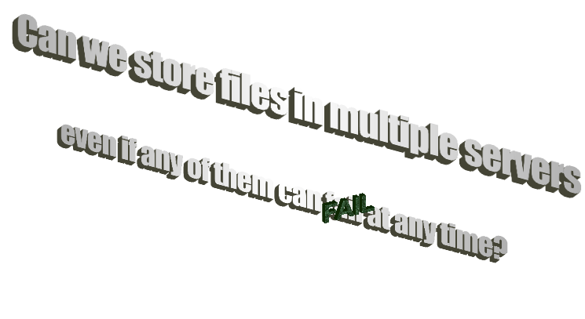

Slide 4


Slide 5


Slide 6

The government could take any of our data centers!
It might sound hard to believe, but as early as 2008, some technologists predict that the government could initiate large-scale tracking operations on its OWN citizens!!!

Slide 7

So let’s give every country a piece of the file!
They can work together!
They can put it back together!
…right?

Slide 8


Better idea
We divide the KEYS into pieces (keys are small!)
Then we give the keys to WAY MORE countries
Even if they don’t have the files

Slide 9



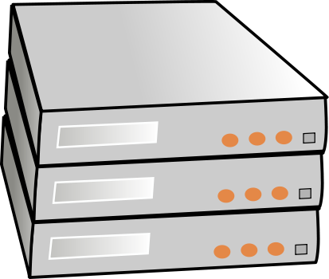
Setup:

Slide 10
Setup:

Slide 11
Setup:

Slide 12
Key sharing details
Shamir’s secret sharing

Slide 13
Key sharing details
Shamir’s secret sharing
Client asks for all replicas for filename & their public keys

Slide 14
Key sharing details
Shamir’s secret sharing
Client asks for all replicas for filename & their public keys
Client makes key-pieces, encrypts w/ public keys, sends to coordinator

Slide 15
Key sharing details
Shamir’s secret sharing
Client asks for all replicas for filename & their public keys
Client makes key-pieces, encrypts w/ public keys, sends to coordinator
When reading, client asks for key pieces

Slide 16
Key sharing details
Shamir’s secret sharing
Client asks for all replicas for filename & their public keys
Client makes key-pieces, encrypts w/ public keys, sends to coordinator
When reading, client asks for key pieces
Replicas encrypt their key pieces w/ client’s public key, send back

Slide 17
Key sharing details
Shamir’s secret sharing
Client asks for all replicas for filename & their public keys
Client makes key-pieces, encrypts w/ public keys, sends to coordinator
When reading, client asks for key pieces
Replicas encrypt their key pieces w/ client’s public key, send back
Client decrypts key pieces, assembles key, decrypts file

Slide 18
Key sharing details
Shamir’s secret sharing
Client asks for all replicas for filename & their public keys
Client makes key-pieces, encrypts w/ public keys, sends to coordinator
When reading, client asks for key pieces
Replicas encrypt their key pieces w/ client’s public key, send back
Client decrypts key pieces, assembles key, decrypts file

Slide 19
Consistency

Slide 20

Consistency

Slide 21
Consistency

Slide 22
Consistency

Slide 23
Consistency

Slide 24
Read Repairs

Slide 25


